Slide 1
Data analysis in r – part II: Descriptive tables, statistical tests & regression

Slide 2
Learning objectives:
By the end of this lesson, learners will learn how to do the following in R:
Design and run logistic regression models using weighted survey data
Create and interpret odds ratio tables
Generate prevalence estimate tables
Create weighted and non-weighted frequency tables

Slide 3
Review survey sampling & weights

Slide 4
Canadian Community health survey – sampling & weights
The CCHS uses a stratified multistage probability sampling method
In probability sampling, each person in the sample “represents” several other persons in the sample
To account for this, we calculate ‘weights’ which are use to determine each persons associated sampling weight
Sampling weights are necessary to derive meaningful estimates from the survey otherwise there is a higher probability of bias

Slide 5
Canadian Community health survey – sampling & weights
The CCHS PUMF provides a weight variable, WTS_M
This sampling weight can be interpreted as the number of people the respondent represents in the Canadian population
This weight must always be used when computing statistical estimates in order to make inference at the population level possible

Slide 6
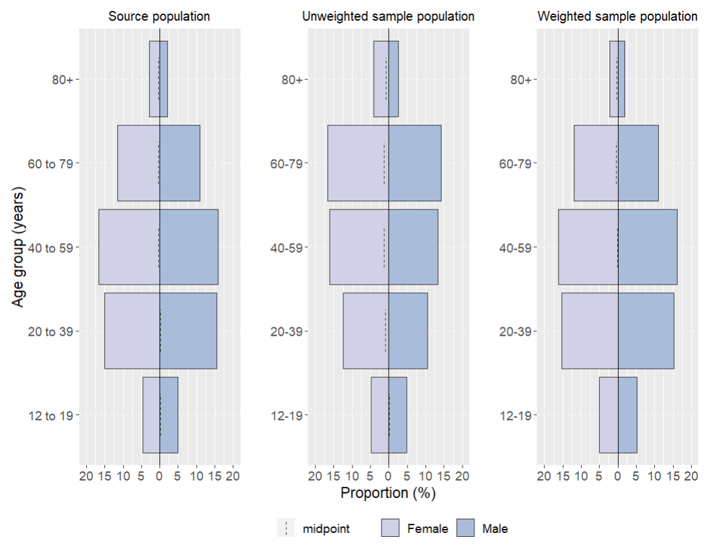
Canadian Community health survey – weights

Slide 7
Population estimates and projections
Population estimates and projections for British Columbia are publicly available on the BC Stats webpage: https://bcstats.shinyapps.io/popApp/
These estimates and projections are a key data source when analyzing population health data
The data can be stratified by region type, region, years, gender and age
After selecting your parameters, you can export the output into a .csv file for analysis

Slide 8
Review using the Canadian community health survey (cchs) data dictionary

Slide 9
Canadian Community health survey – data dictionary
A data dictionary of variable names, concepts, universe statements and frequencies are provided in the CCHS 2015-2016 PUMF DataDictionary Freqs file on Brightspace
The data dictionary shows four columns for each variable:
1. Content – The text label for each of the response categories.
2. Code – The numerical value associated with each category.
3. Sample – The unweighted frequency on the file of respondents with each response.
4. Population – The weighted frequency for the response.

Slide 10
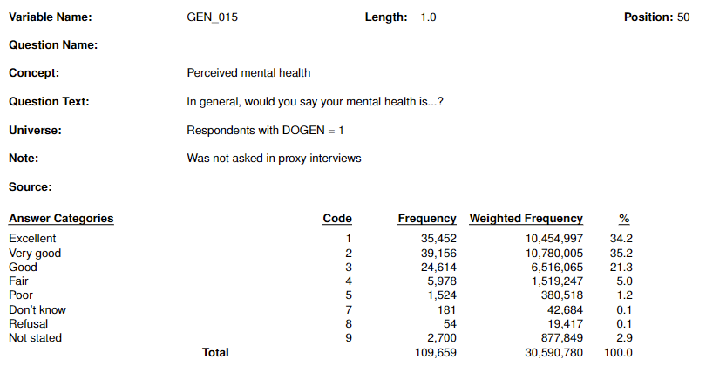
Canadian Community health survey – data dictionary
3. Sample – The unweighted frequency on the file of respondents with each response.
1. Content – The text label for each of the response categories.
2. Code – The numerical value associated with each category.
4. Population – The weighted frequency for the response.

Slide 11
Preparing your dataset for analysis

Slide 12
Recoding variables as factors
Logistic regression is often used to model relationships between categorical predictors (independent variables) and binary outcomes (dependent variables)
Using factors for categorical predictors is good practice because it avoids potential misinterpretations and ensures that the model correctly handles categorical data
When you use integers to represent categories, the model may interpret the numeric values as if they have a meaningful order, which may not be the case for categorical data

Slide 13
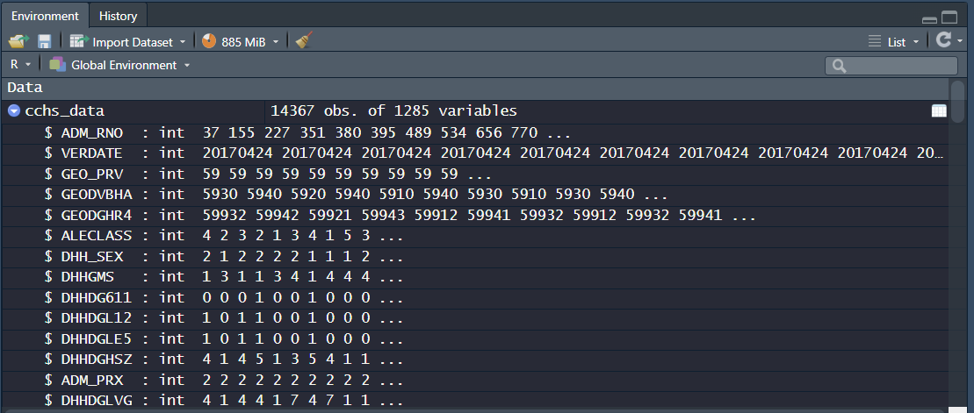
Recoding variables as factors
Before being used in your analysis, categorical variables must be recoded as a factor – failure to do so may result in incorrect modelling

Slide 14
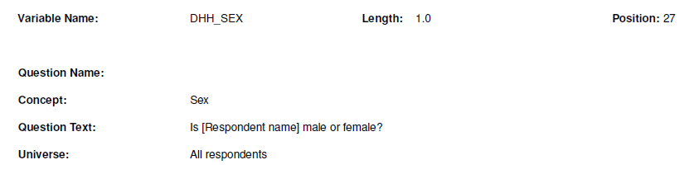
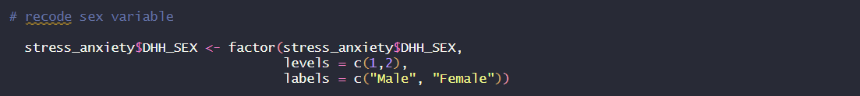

Recoding variables as factors
Variable to recode
The levels (integers) representing the data
The labels to be assigned to each level (integer)
Data frame
labels
levels

Slide 15
Creating a survey design
We can use the as_survey_design() function from the survey package in R to create a survey design object from a dataset
The as_survey_design() function allows you to specify the following survey sampling design features:
Strata: subpopulations or groups within the overall population that share similar characteristics or attributes
Cluster: groups or units that used in the sampling process to help streamline the data collection processes
Weights: used to obtain population level estimates from the survey sample

Slide 16
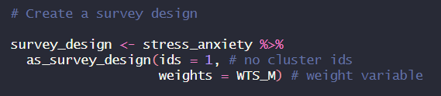
Creating a survey design
survey_design: the name of the survey design object we are creating
stress_anxiety: the name of the data frame we are using to create the survey design
as_survey_design: the survey design function used to create a survey design
ids: the variable that contains the cluster ids (not applicable to our survey so we set it to 1 to treat all observations the same)
weights: the survey weight variable provided in our CCHS dataset (WTS_M)
strata: the variable that contains the stratum identifier (not applicable so we can leave it out)
*Modify the object in the red box to the name of your dataset

Slide 17
Dependent & independent variables
Dependent Variable:
Also known as the response variable or outcome variable
This is your binary variable (eg. “yes/no”, “success/failure”, “1/0”) that represents the outcome or event of interest
Independent Variables:
Also known as predictor variables
The values of these variables are used to estimate the log-odds (logit) of the dependent variable taking a particular value

Slide 18

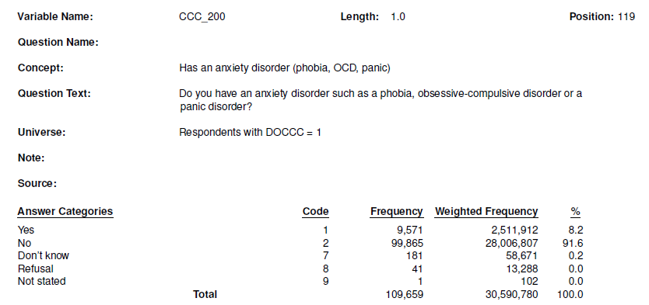
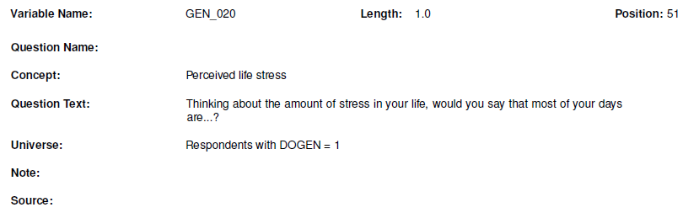
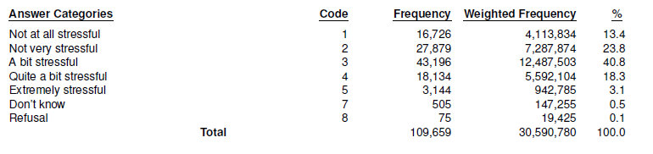
Dependent & independent variables
REMEMBER: logistic regression analyzes binary outcomes – think of it as trying to detect the presence or absence of something
dependent variable
You can group your data accordingly if you want to assess the outcome of a variable that is not currently binary
independent
variable

Slide 19


Slide 20
Building a regression model in R

Slide 21
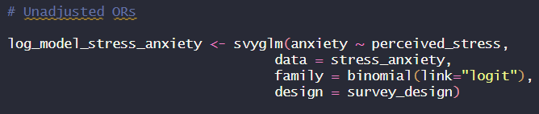
Building a regression model in R
We can use the svyglm() function from the survey package to fit a generalized linear model (GLM) to our survey data
The svyglm() function was specifically designed to work with complex survey designs, therefore, we can use it to incorporate the survey_design we created into our model
The svyglm() function can be used for various types of regression (eg. logistic regression to analyze binary outcomes, linear regression for continuous outcomes etc.)

Slide 22
Building a regression model in R
log_model_stress_anxiety: the name of the object we are creating
svyglm: the function used to fit generalized linear models (GLM) to survey data
anxiety ~ perceived_stress: the dependent variable (anxiety) and independent variable (perceived_stress) we are modeling the relationship between
data: the dataset we are using for the analysis
family: the family (binomial) and link function (logit) for the GLM; used to fit a logistic regression model
design: the survey design we previously created
*Modify the objects in the red boxes to run regression on your selected variables

Slide 23
Building a regression model in r
In this code, we are using logistic regression to model the probability of anxiety (dependent variable) based on the values of perceived stress (independent variable)
We are trying to answer the question: how do changes in perceived stress relate to the likelihood of having an anxiety disorder?

Slide 24
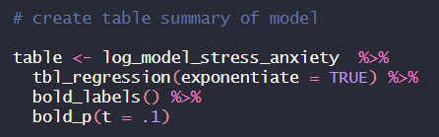
Creating a table output
Now that we have built our model, we can generate a table to present our logistic regression model in:
table: the name of the object we are storing the results from our logistic regression model in
tbl_regression(exponentiate = TRUE): create a regression table from the logistic regression model; display exponentiated coefficients (used to interpret odds ratio)
bold_labels() & bold_p(t = .1): bold variable labels and bold p-values if they are less than or equal to 0.1

Slide 25
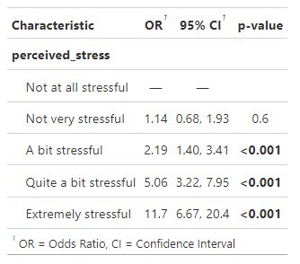
Interpreting the results
This is an unadjusted odds ratio table – it does not account for potential confounding factors
It shows that those with an anxiety disorder are more likely to experience perceived stress
Those with an anxiety disorder are 11.7 times more likely to report most days in their life as being ‘extremely stressful’

Slide 26
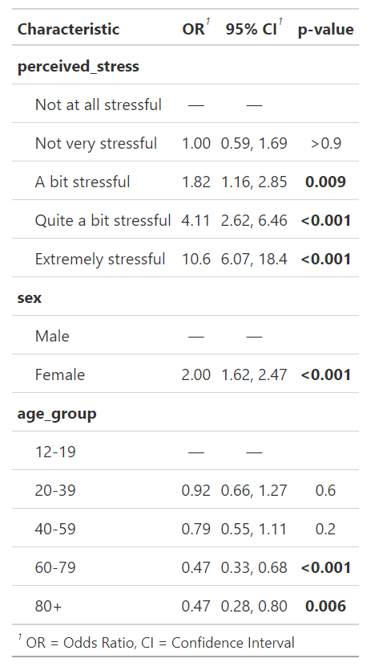
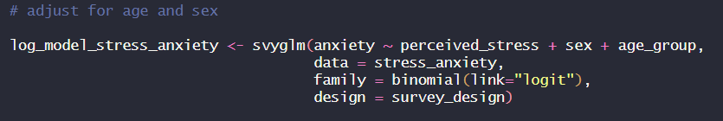
Interpreting the results
Unadjusted odds ratio
Adjusted odds ratio
We can adjust our code to adjust for potential confounding factors to create an adjusted odds ratio
In this example, we are controlling for age and sex

Slide 27
Interpreting the results
An odds ratio (OR) greater than 1 means the event is more likely to occur in the group of interest compared to the reference group
Example: Females are approximately twice as likely to report an anxiety disorder compared to males
An OR less than 1 means the event is less likely to occur in the group of interest compared to the reference group
Example: 60-79 year olds are approximately 53% (1 – 0.47) less likely to report an anxiety disorder compared to 12-19 year olds

Slide 28
weighted prevalence estimates

Slide 29
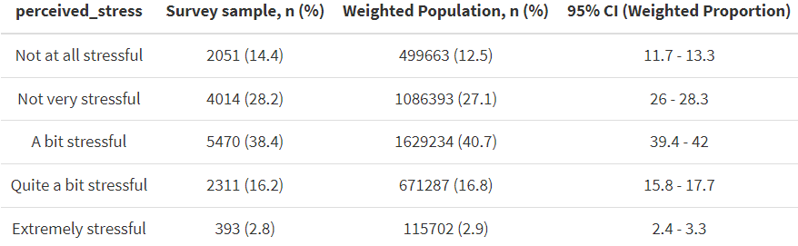
Weighted prevalence estimates
Weighted prevalence estimates are used to determine the occurrence of a particular characteristic in a population while taking into account differences in the survey sample

Slide 30
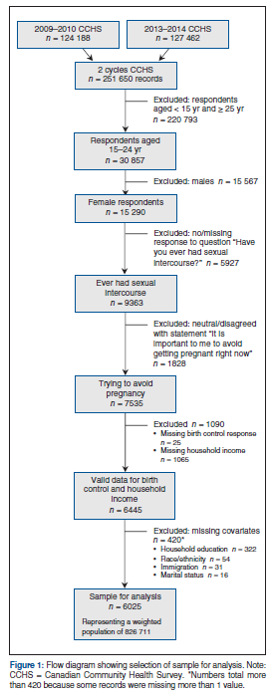
Sample selection for analysis

Slide 31
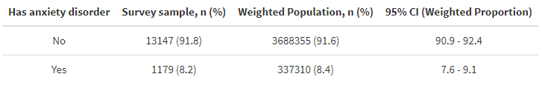
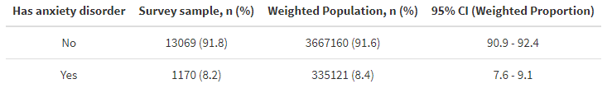
Why are these results different?

Slide 32
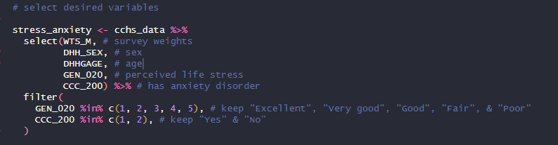
Filtering
In the filter stage, variables that don’t meet the specified criteria are dropped from the analysis
It is important to report in your analysis the number of respondents included/excluded as a result of your inclusion criteria

Slide 33
Determining The number of excluded responses
Look at the data dictionary provided to see which codes are excluded

Slide 34
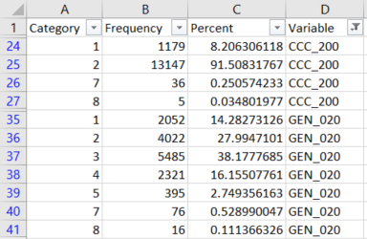
Determining The number of excluded responses
Use the Non-Weighted Frequency Table output (generated in R) to determine the number of responses removed
Tip: Filter on the variable(s) of interest to reduce the number of rows you need to sort through
Example: We excluded 41 respondents who were missing information on anxiety disorder and 92 respondents who were missing information on perceived life stress

Slide 35
Determining The number of excluded responses
Use the non-weighted frequency weight table to determine the number of excluded survey respondents
** The current code provided is sample code and does not provide an exhaustive list of variables
You may need to add your desired variables to the list to obtain the frequencies

Slide 36
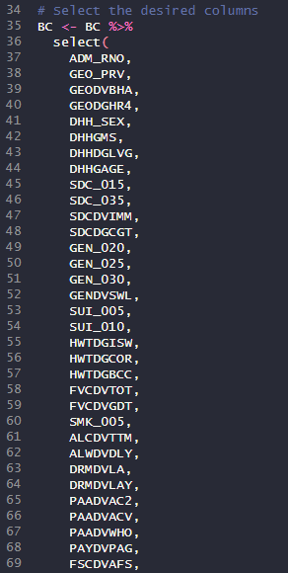
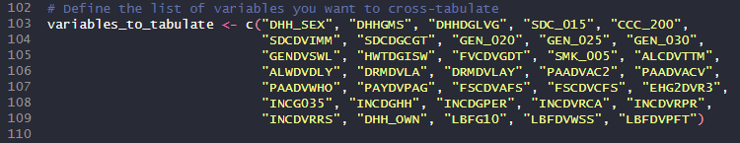
Modifying the frequency table output
Add the variable to each block of code noted here in the ‘Frequency Table Code’ script to add it to your frequency table output
Make sure you use the same format as in the sample code (eg. quotation marks, commas)

Slide 37
Mini assignment #10
Adjust the code in the ‘Week 10 – Odds Ratio’ R script to run logistic regression models using the variables you selected in Week 9
Run the ‘Frequency Table Code’ R script and use the CCHS Data Dictionary to determine how many survey responses were removed for your analysis
Submit your odds ratio table and the number of survey responses removed for each variable used in your analysis to Mini Assignment #10 on Brightspace

